Slide 1
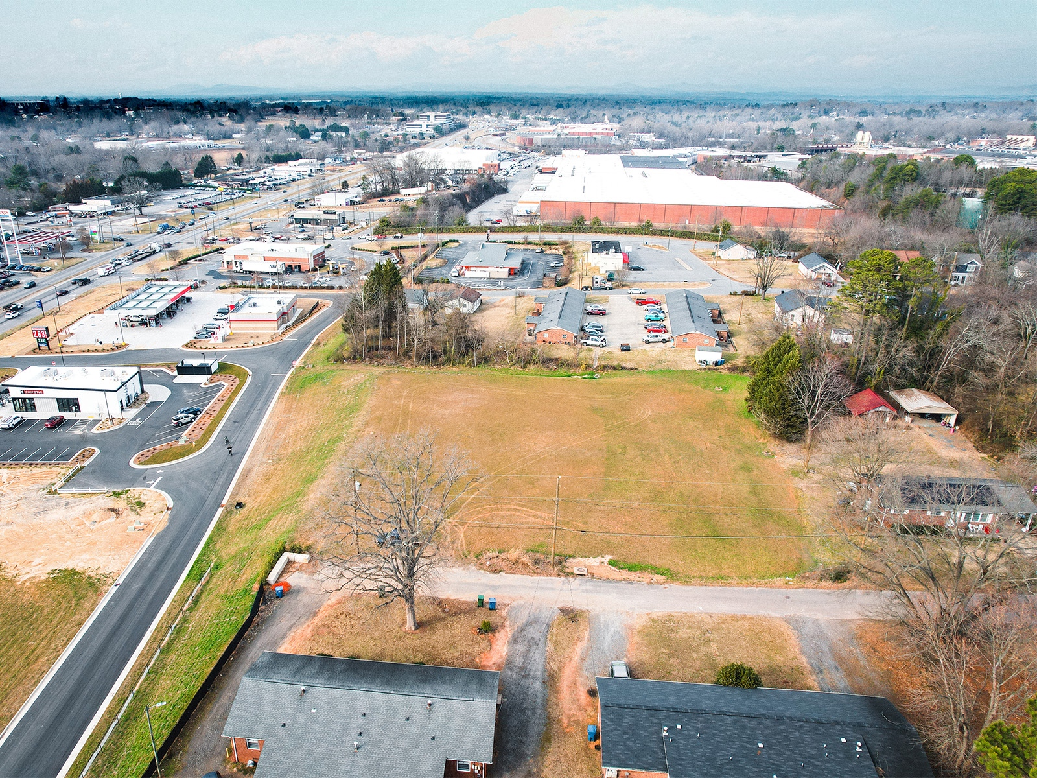

LAND ON HWY 321
80 HWY 321 NW Hickory, NC 28601

Slide 2
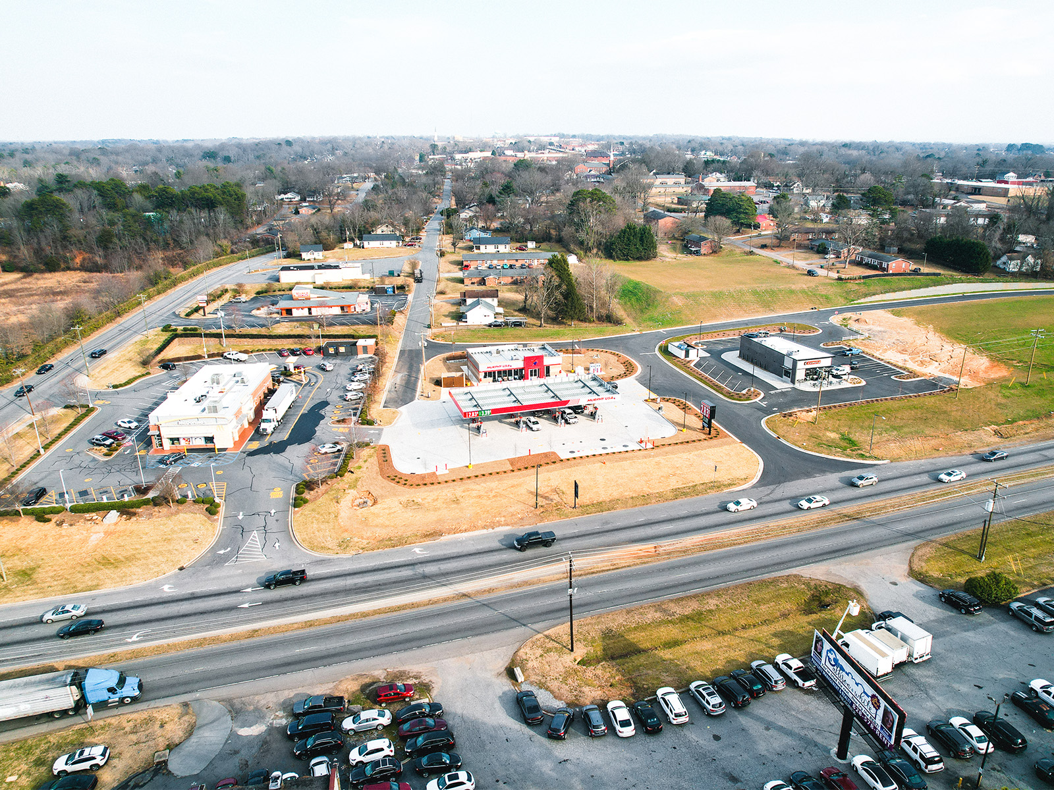





aerial
1.6 +/- Acres
Hwy 321 (38,300 CPD)

Slide 3

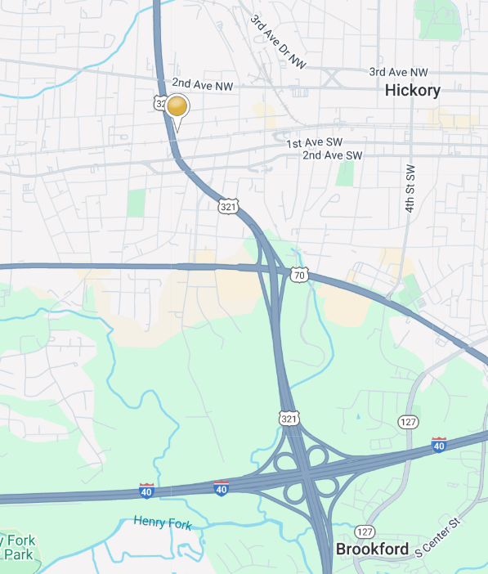
DETAILS
SPECIFICATIONS
Price:
Acres:
Zoning:
$349,900 (REDUCED!)
1.62 +/- Acres
C-2
Whether you are looking to establish a new business, expand operations, build a QSR or invest in a highly desirable location, this parcel provides the perfect opportunity! It is suitable for a variety of commercial uses and provides
Highway 321 visibility and accessibility, with easy access to Interstate 40.
DEMOGRAPHICS
RADIUS
Total Population
Total Household
Median Household Income
Total Employees
1 MILE
5,849
2,519
$51,652
8,310
3 MILE
31,011
13,042
$62,810
32,897
5 MILE
68,323
28,660
$68,342
47,974

Slide 4
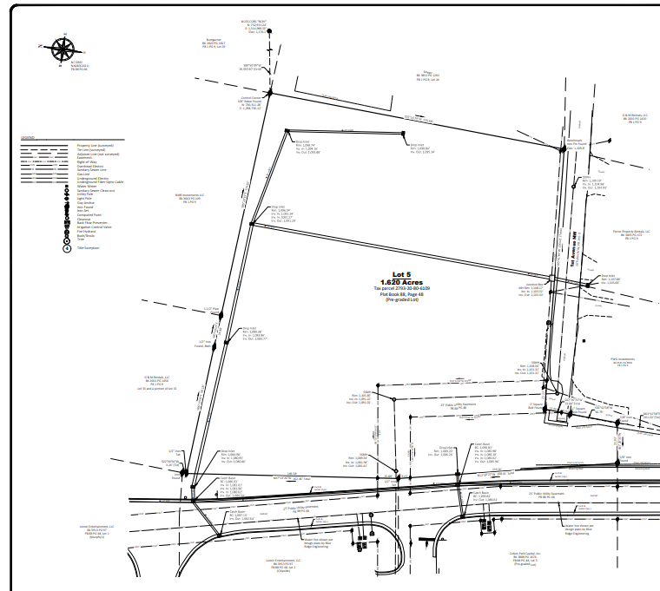
SURVEY

Slide 5
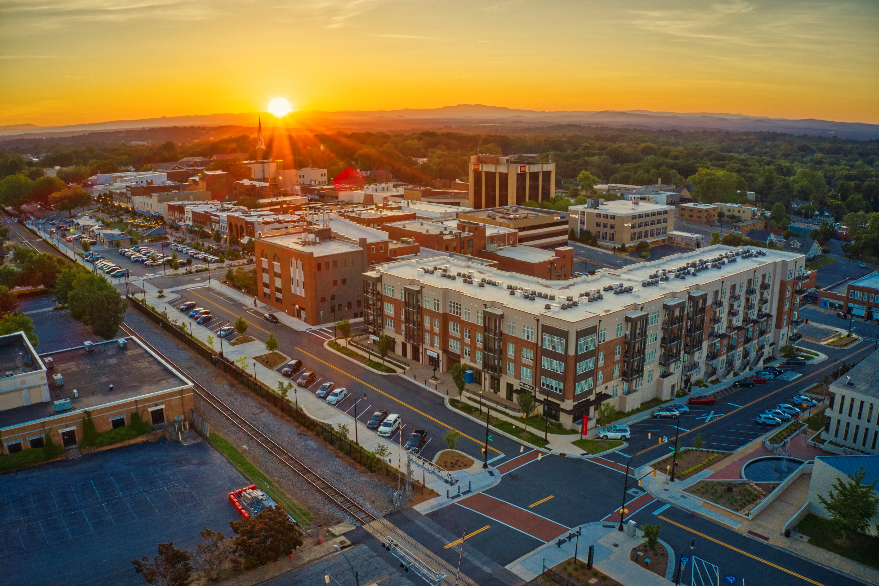
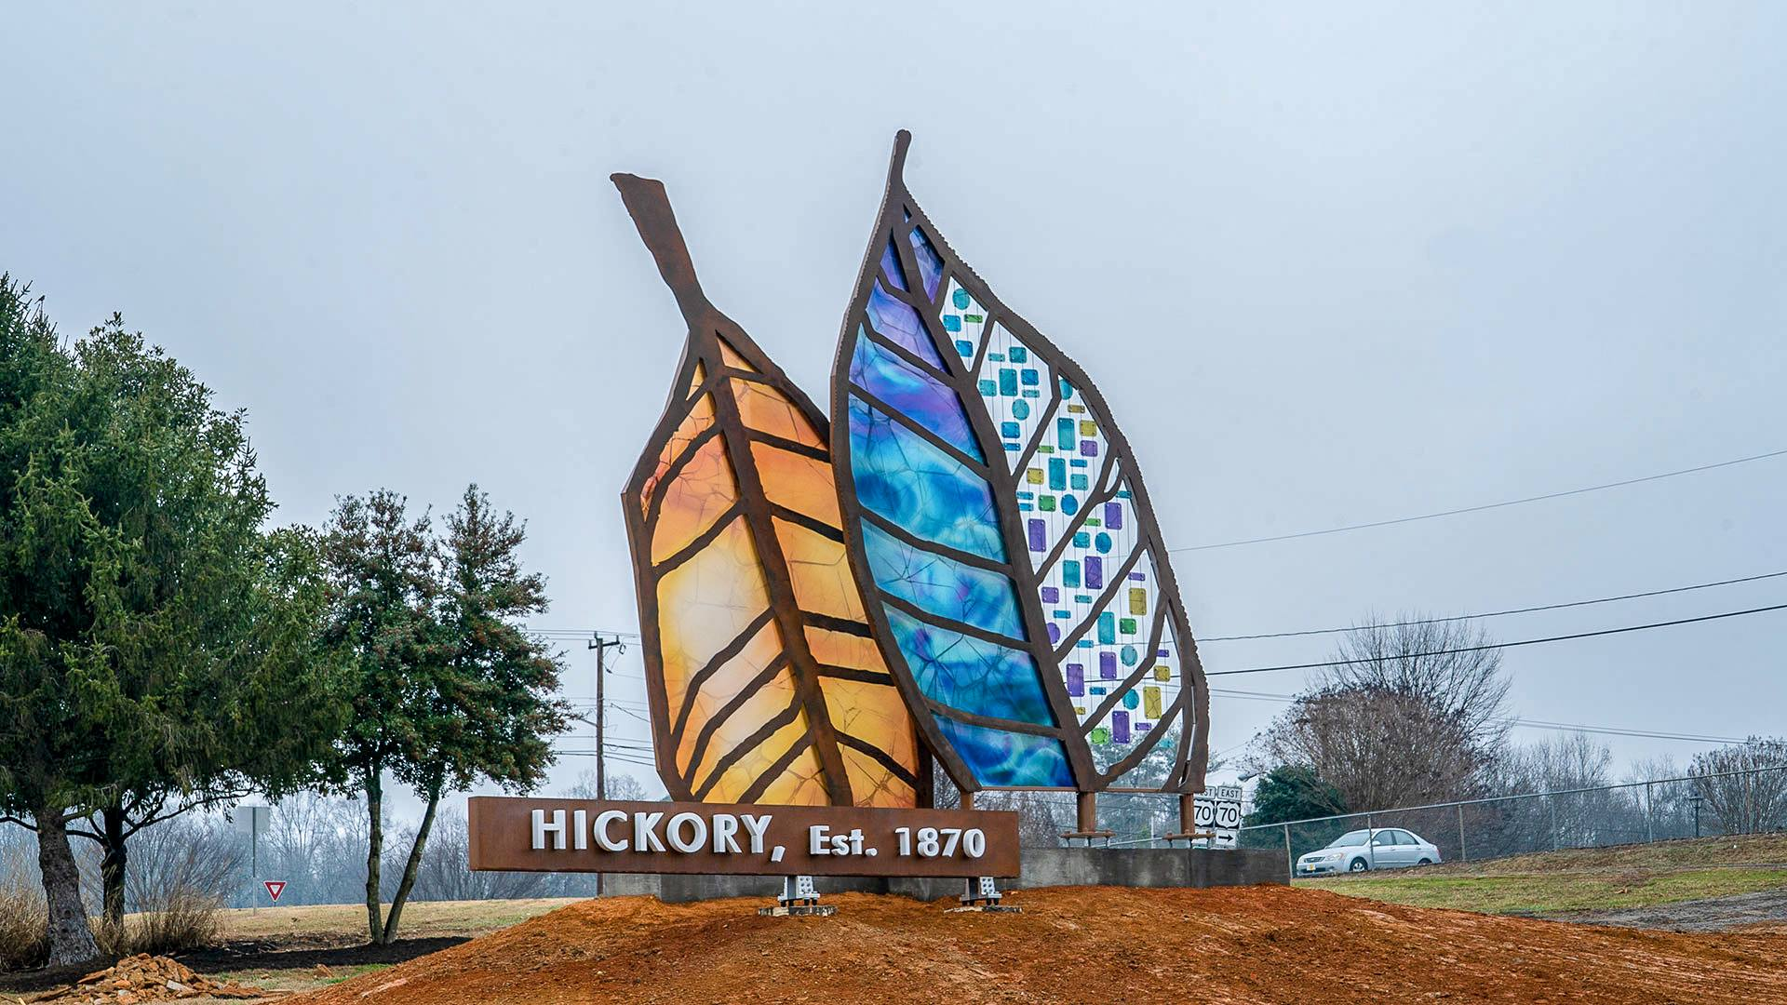
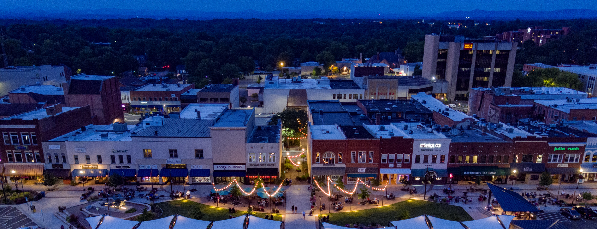
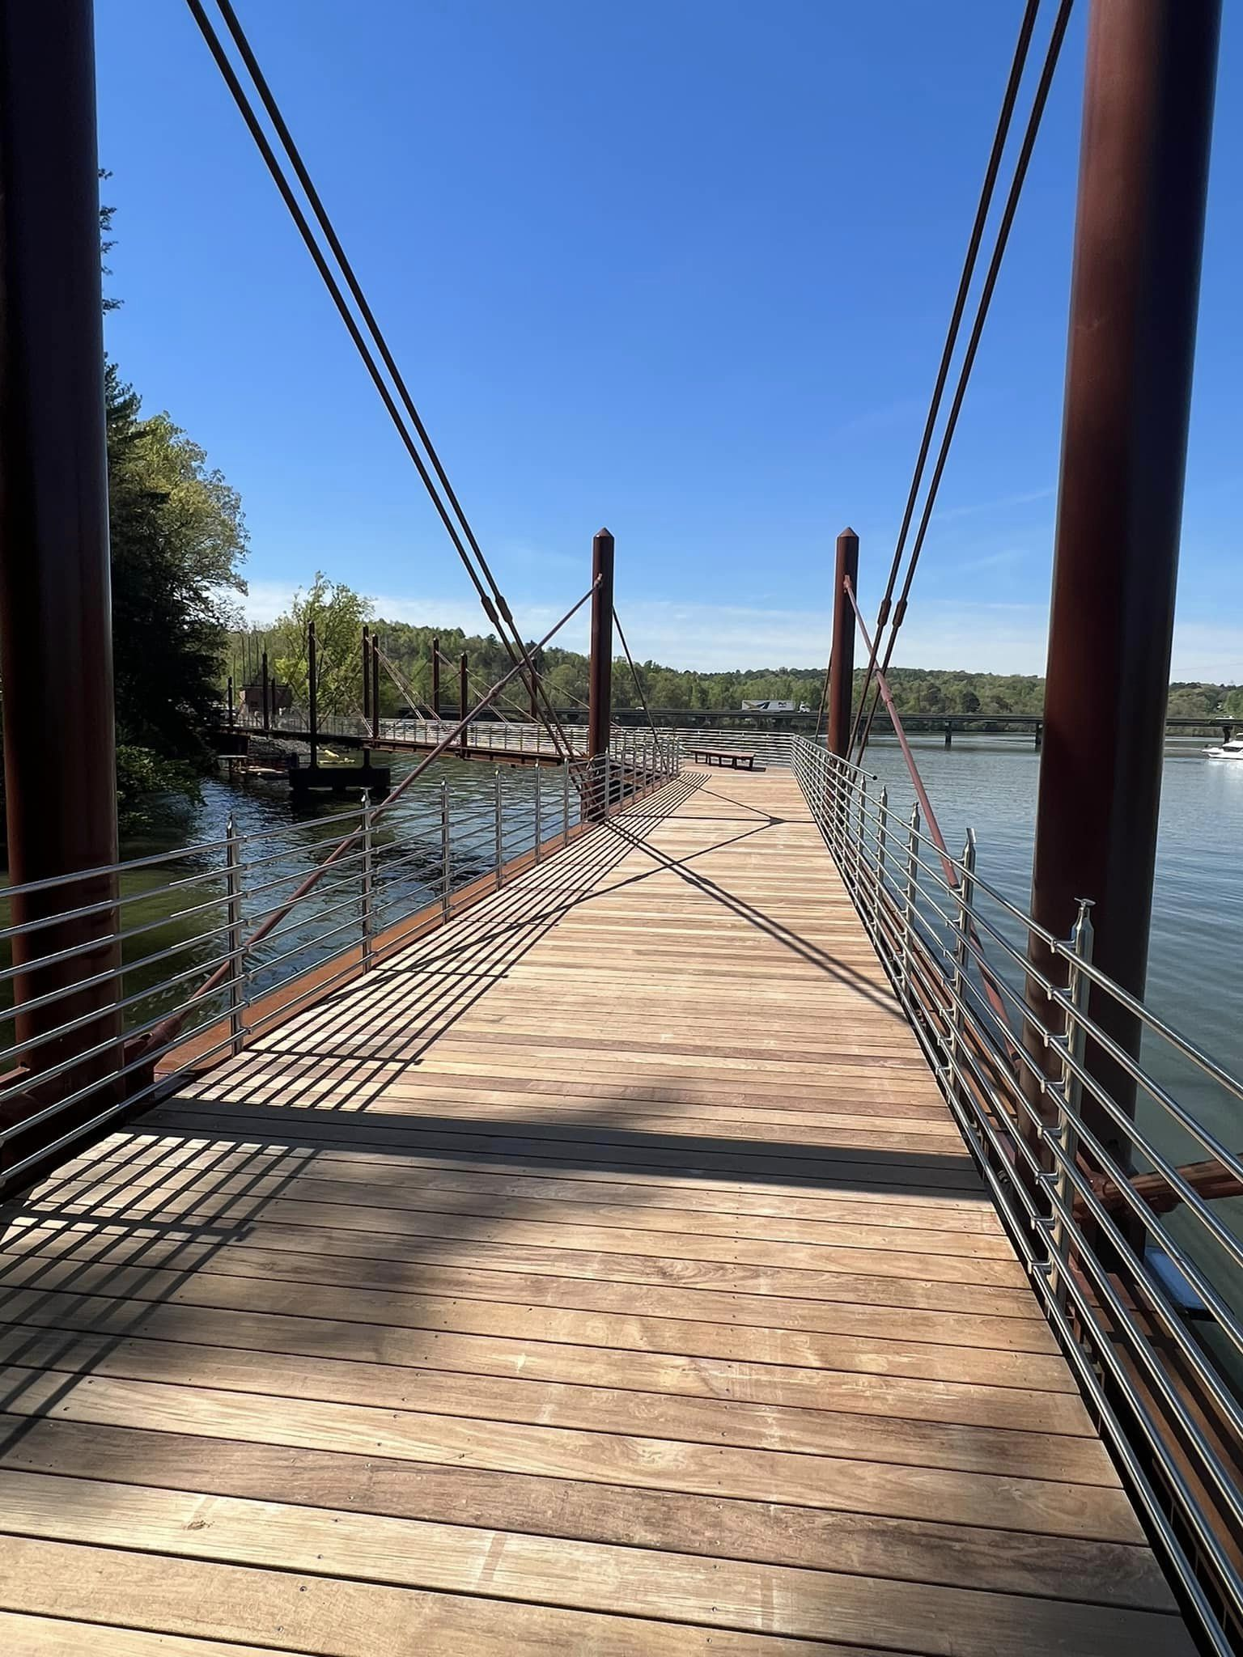
market overview
HICKORY, NC
Hickory is for doers and makers seeking a well-rounded community. Our city is a three-time All-American City and the regional hub of a metropolitan area of 365,376 people. Hickory and the metro area have strong transportation, utility, higher education, cultural, and workforce development networks that have produced a robust manufacturing base and extensive medical, retail, service, and residential development.

Slide 6
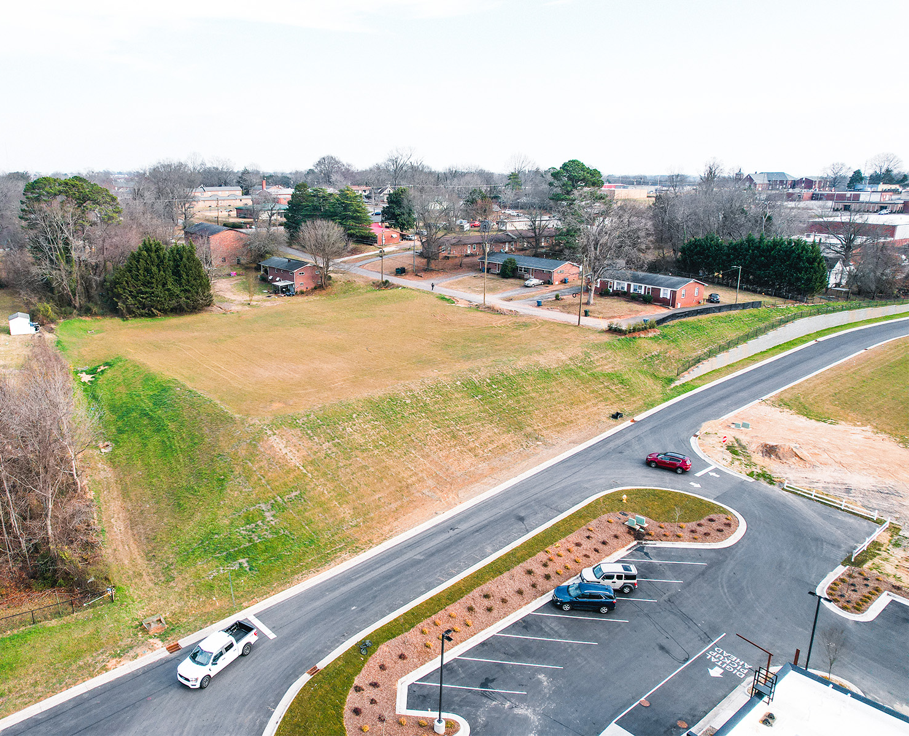

FOR MORE INFORMATION:
Shana White
828.446.3404
shana@commercialfirst.net
3031 N Center St.
Hickory, NC 28601
www.commercialfirst.net

